Slide 1
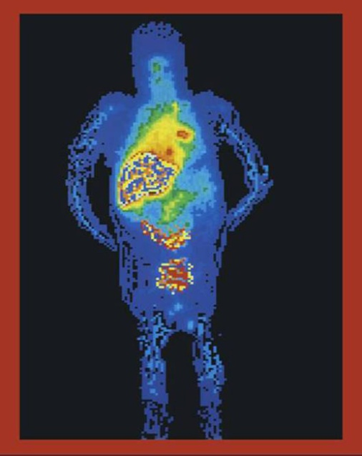
Poster title
Export your PowerPoint Poster as a PDF. When printing, select custom size and enter 42 in WIDE x 82 in HIGH (106.68 x 208.28 cm).
Click here to add title
Authors, FIRST NAME INITIAL, SURNAME, presenting author(s) underlined, Affiliations1 numbered in superscript
B. SMITH ¹, N. HARRISON ² and P. MATTHEWS³
1. University of New South Wales, Sydney, Australia
2. Royal Brisbane Hospital, Brisbane, Australia
Add your logo here
Click here to add authors
Click here to add affiliations
Introduction
Results
You may edit the size of the font, the sections distribution and the color scheme if wanted. All modifications concerning the background/title display are to be done at a Master Slide level.
Tips for creating a successful poster…
Re-write your paper into poster format i.e. simplify everything, avoid data overkill.
Headings of more than 6 words should be in upper and lower case, not all capitals. Simplify the titles.
Try not to write whole sentences in capitals or underline to stress your point, use bold characters instead.
When laying out your poster, leave white space around your text. Don’t
overcrowd your poster.
Spell check and get someone else to proof-read.
Aim
How to use this poster template…
Simply highlight this text and replace it by typing in your own text or copy and paste your text from a MS Word document or a PowerPoint slide presentation.
Objectives
The body text / font size should be no smaller than 20 points. Try to keep body text left-aligned, do not justify text.
Methods
Summary
Copy and paste your text content here, adjusting the font size to fit.
Copy and paste your text content here, adjusting the font size to fit
Discussion
Copy and paste your text content here, adjusting the font size to fit.
Tips for Inserting Graphs/Images
Note: Skip the following procedure if your graphs were created in PowerPoint®, Illustrator (eps file) or Excel.
Image checking procedure: After you insert the image (72 dpi screen resolution) and resize* to fit, right click on it and select Format Picture.) When the pop-up window comes up, click on size and check the scale. The image will print better if its width and height scale is at 25% or lower (20% or 10%, etc.)
If the scale of the image is higher than 25%, try to replace it with a larger size (more dpi, 300dpi) image if possible. If the resolution of the image is 300 dpi or higher (400 or 600 dpi), then check to make sure its scale is not higher than 100%.
References
Journal Article, Name of Journal
Journal Article, Name of Journal
Journal Article, Name of Journal
Journal Article, Name of Journal
Insert Footer or Copyright Information Here
SOHO2025

