Slide 1

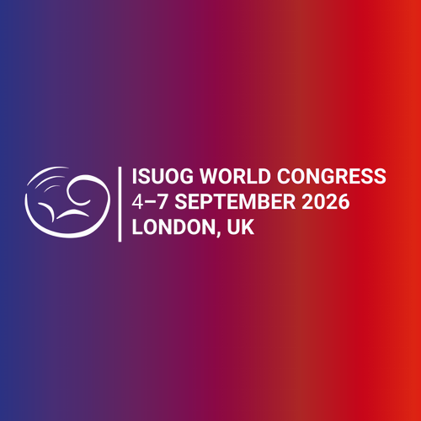
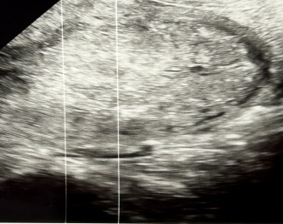
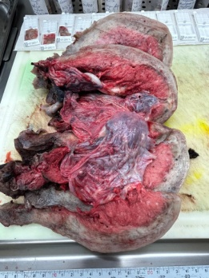
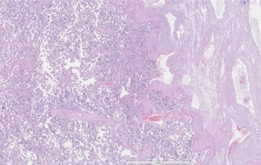
Anca-Teodora Constantin, MDOBGYN,
National Institute for Mother&Child Healthcare Bucharest,Romania
Tiberiu-Augustin Georgescu, Pathologist, National Institute for Mother&Child Healthcare , Bucharest, Romania
Case report of Placenta accreta spectrum (PAS) with intrapartum diagnosis and management
INTRODUCTION:
1937- obstetrician Frederick C. Irving and pathologist Arthur T. Hertig-pivotal publication and definition of PAS
PAS incidence is continuously increasing in the last decades:
- Major risk factors: prior cesarean section (CS) and placenta praevia (PP)
- Additional risk factors: uterine pathology (adenomyiosis, endometritis), multiparity, previous uterine surgeries or curettage, Asherman syndrome, assisted reproductive technologies (ART), smoking.
CLINICAL CASE:
32 yrs.female,P3, 38GW presents in the first stage of labour for delivery;
POH (past obstetric history): 2 previous vaginal births – ART (IVF) pregnancies (hydrosalpinges and bilateral salpingectomy);
Following the vaginal birth placenta did not deliver after 30 minutes despite active management (uterotonics,cord traction) and gentle manual removal failed to find the clivage plane;
Clinical diagnosis of PAS was set and sustained by transabdominal Us. (Fig.1);
Absence of PPH (postpartum hemorrhage) - conservative management was tempted for uterine arteries embolization, considering patient desire for future fertility;
PPH prophylaxis: continuous oxytocin infusion, rectally misoprostol, antibiotic prophylaxis;
Intensive maternal monitoring: vaginal bleeding, vital signs, hemodynamic and biochemistry parameters;
1,5 hrs. postpartum - massive vaginal hemorrhage - hemostasis hysterectomy (Fig. 2).
IMAGING RESULTS:
CONCLUSIONS:
Systematically consider early (1st trimester) Us. screening for PAS in subsets of women based on risk factors stratification.
Clinical factors remain equally important predictors.
Us. follow-up at 18-20, 28-30, 32-34 GW in asymptomatic patients (ACOG Recommendations).
Optional complementary MRI at 28 GW (Cristina. Bradeanu, radiologist-fetal MRI - good medical practice standards).
MRI improves sensibility and sensitivity of diagnosis (depth of invasion percretism signs of periuterine invasion,abnormal vascularity) in difficult
(e.g.: posterior PP). or inconclusive cases.
Multidisciplinary care team optimizes management (complex cesarean, conservative or extirpative procedure), outcome and confidence of care.
Histopathologic confirmation is golden standard for PAS diagnosis (Fig. 3).
Clinical-imaging-pathologic correlation is essential for improving PAS incidence data, targeted screening, diagnosis skills and management protocols.
Fig .1 Postpartum Us.- Posterior and fundal retained placenta with irregular maternal border, focally absent hypoechoic retroplacental space, thin underlying myometrium
(<1 mm)
Fig.2 Uterine specimen with placenta in situ
(PAS-
Grade 2)
Fig. 3 Histopathology – Thin decidua and Nitabuch layer, focally absent decidua

